Slide 1
Discrete Mathematics
Xiaowei Yang
South China University of Technology

Slide 2
Chapter 8. Graphs
Graph Terminology
Section 8.2

Slide 3
Contents
1
Basic Terminology
2
Some Special Simple Graphs
3
Bipartite Graphs
4
Some Application of Special Types

Slide 4
Basic Terminology

Slide 5
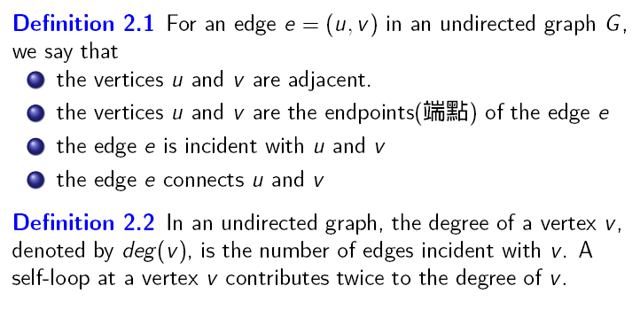

Slide 6
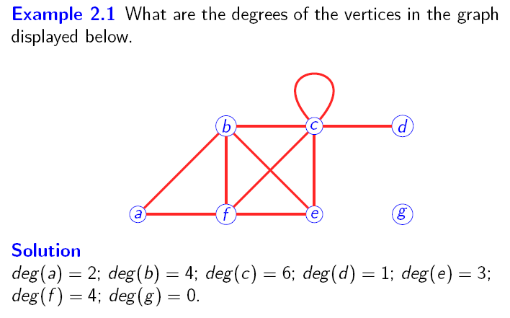

Slide 7
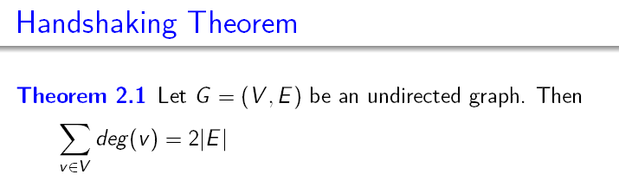


Slide 8

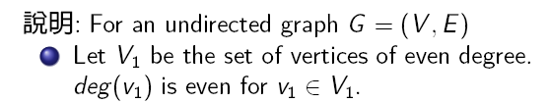

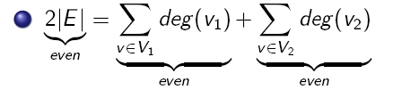


Slide 9
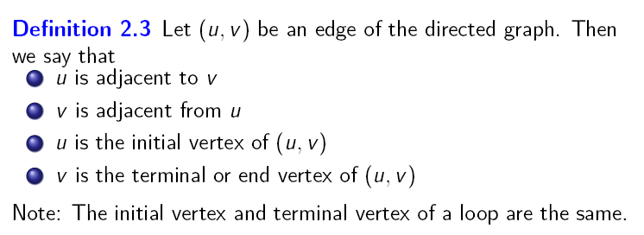

Slide 10

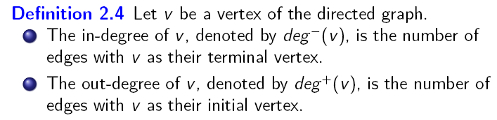
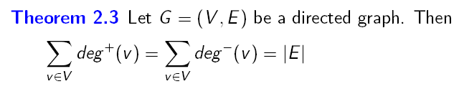

Slide 11
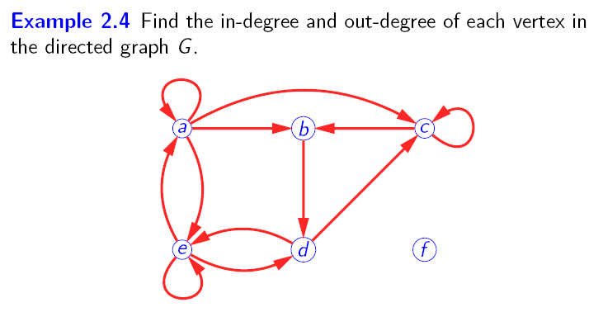
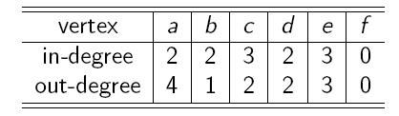

Slide 12
Some Special Simple Graphs

Slide 13
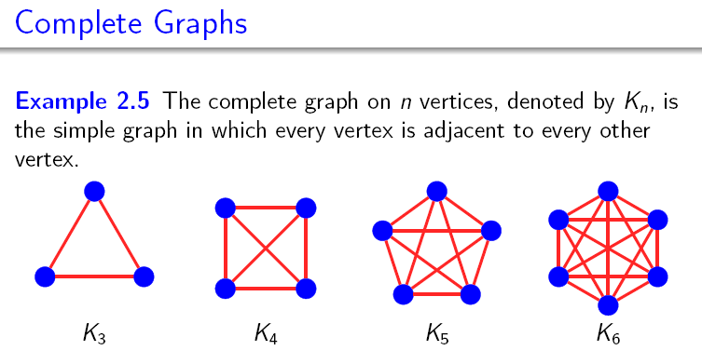

Slide 14
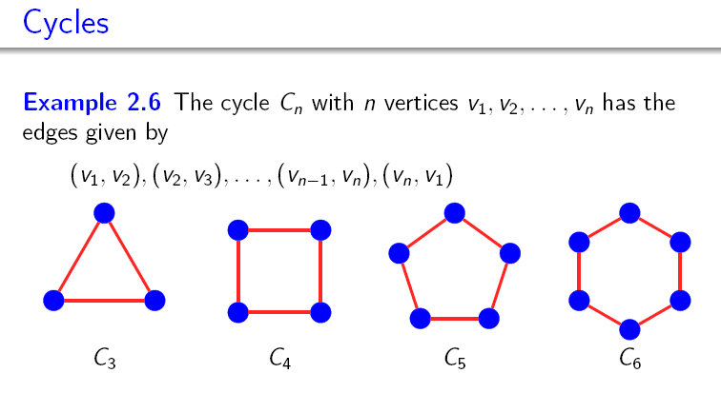

Slide 15
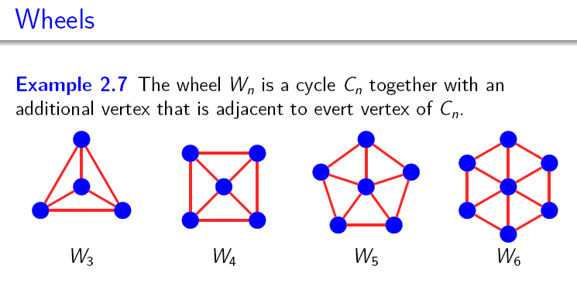

Slide 16
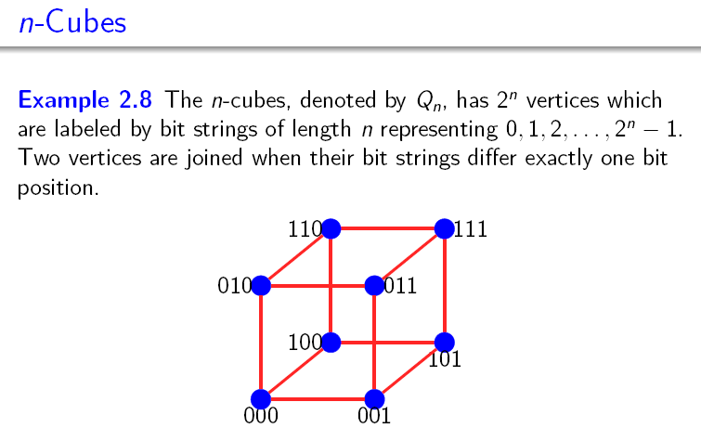

Slide 17
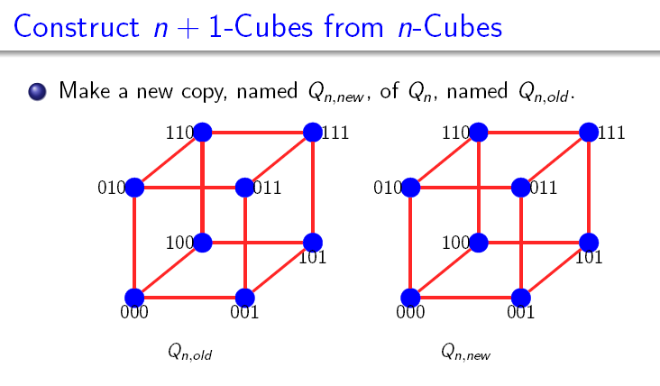

Slide 18
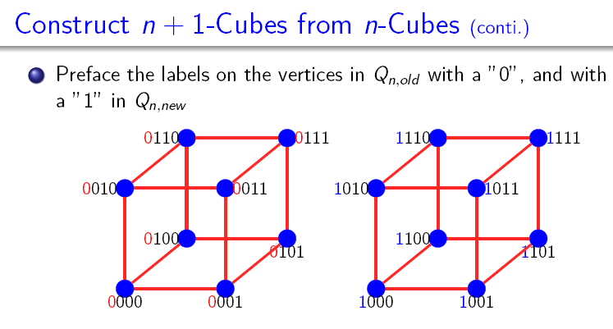

Slide 19
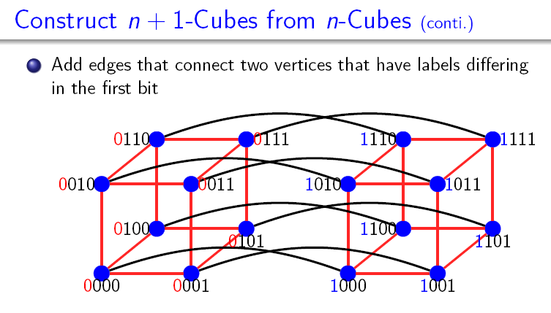

Slide 20
Bipartite Graphs

Slide 21
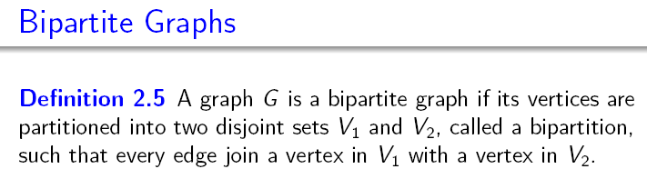

Slide 22
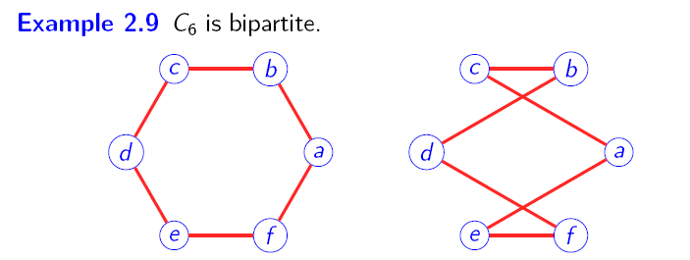


Slide 23
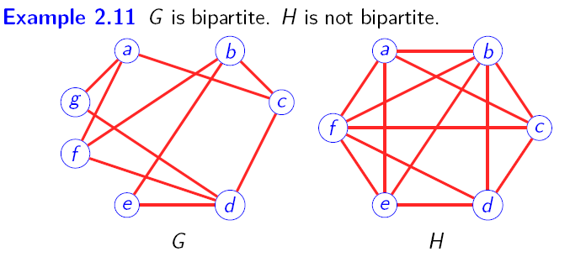

Slide 24
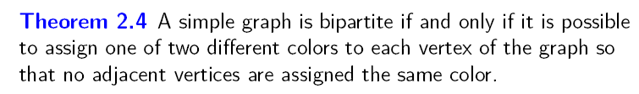
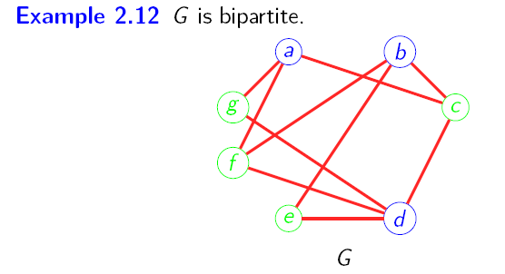

Slide 25
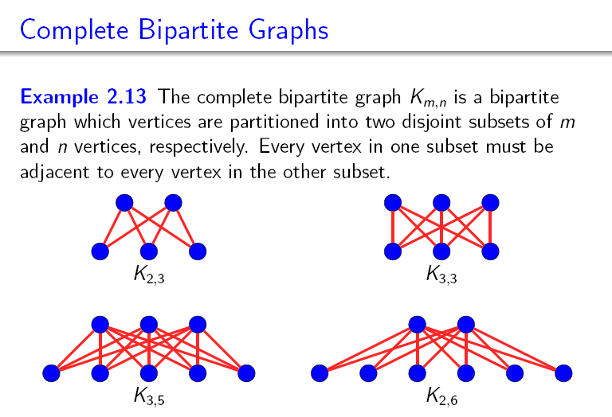

Slide 26
Some Application of Special Types

Slide 27
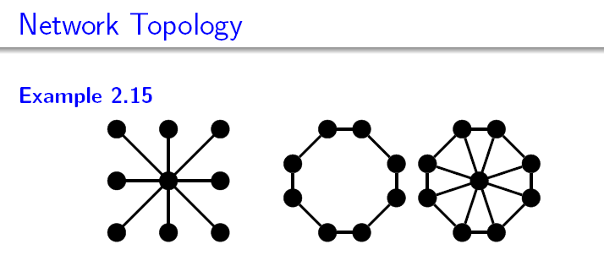



Slide 28
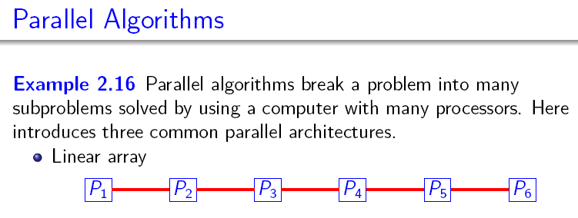

Slide 29
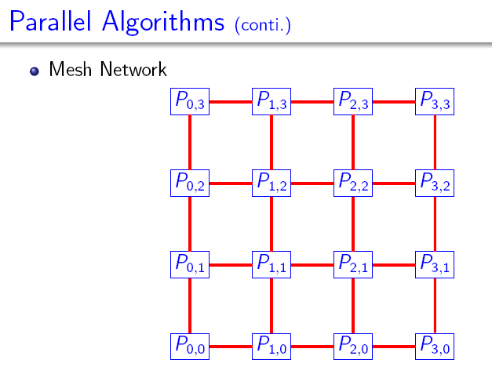

Slide 30
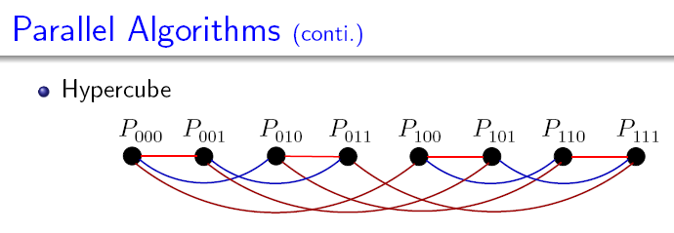

Slide 31

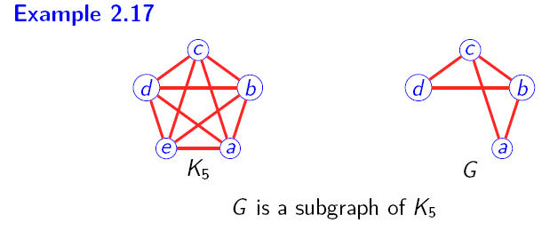

Slide 32

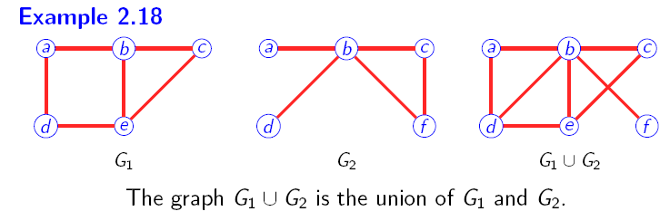

Slide 33
Applications

Slide 34
Applications
A
Solve the following problems.
1) Graph S, constructed by some cities and the roads among them. The graph contains 16 edges. And the degree of each vertex is 2. How many cities?
2) Graph T, constructed by some harbors and the waterways. The graph contains 21 edges. 3 of the vertices have the degree of 4, and the others have the degree of 3. How many harbors?

Slide 35
Applications
A
Solve the following problems.
1) Graph S, constructed by some cities and the roads among them. The graph contains 16 edges. And the degree of each vertex is 2. How many cities?
Solution. There are 16 cities. Suppose there are x vertices. Hence,
the sum of degree= 2*|E|
2x = 2*16
x=16.
2) Graph T, constructed by some harbors and the waterways. The graph contains 21 edges. 3 of the vertices have the degree of 4, and the others have the degree of 3. How many harbors?
Solution. There are 13 harbors. Suppose there are x vertices. Hence,
the sum of degree= 2*|E|
3*4+(x-3)*3 = 2*21
x=13.

Slide 36
Applications
A
2. How many vertices in the following graphs?
1) K_{n} 2) C_{n} 3) W_{n} 4) K_{m,n}

Slide 37
Applications
A
2. How many vertices in the following graphs?
K_{n} 1+2+…+n=n(n-1)/2
C_{n} n
W_{n} 2n
4) K_{m,n} mn

Slide 38
End of Section 6.2
Click to edit company slogan .

